Slide 1

E-Scooter Share Pilot in Chicago
Ziyi Yang

Slide 2
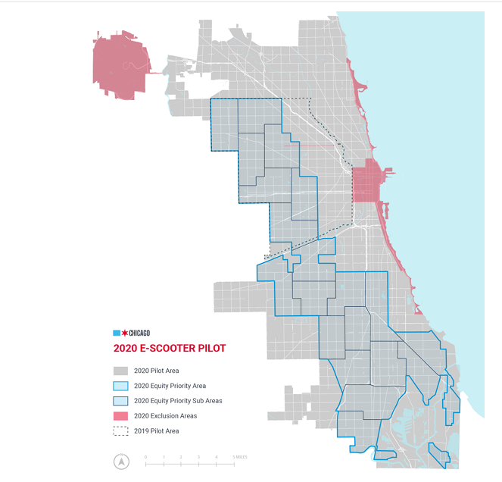
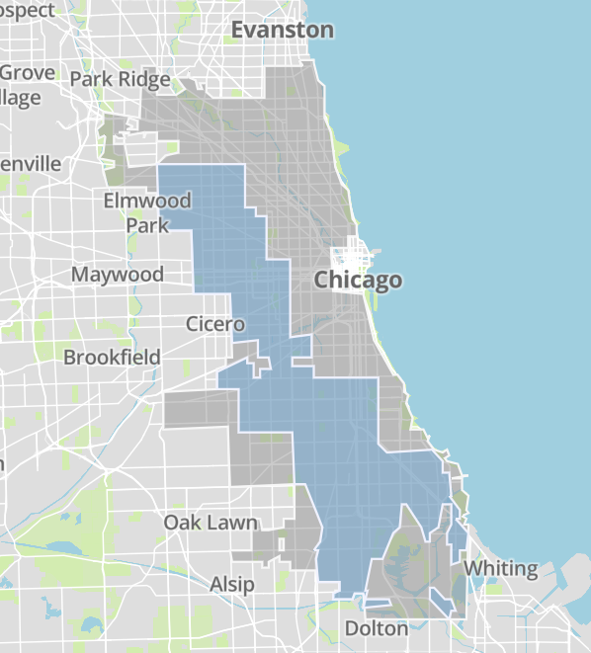
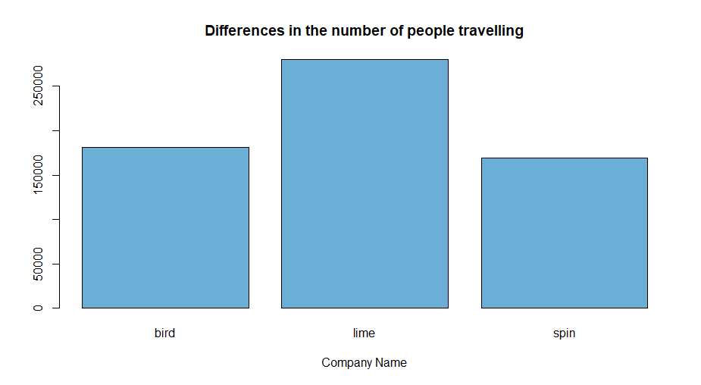
Time: August 12, 2020 to December 12, 2020
Vendors: Bird, Lime and Spin
Each company can offer 3,333 rentable scooters each day between 5 a.m. and 10 p.m.
Price: 1$ to unlock + Bird (32 cents/min)
Spin (39 cents/min)
Lime (19 cents/min in priority areas and 39 cents/min elsewhere)
Notes:
In 2019 and 2020, the city of Chicago conducted a four-month scooter sharing pilot to evaluate the feasibility of Chicago scooter sharing, test technology and rules, and better understand how to form a more durable program.

Slide 3


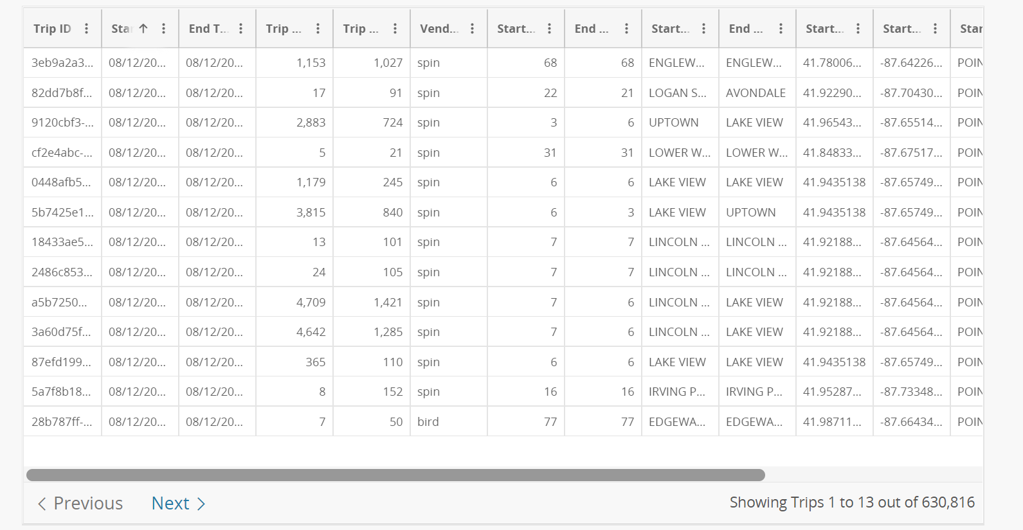
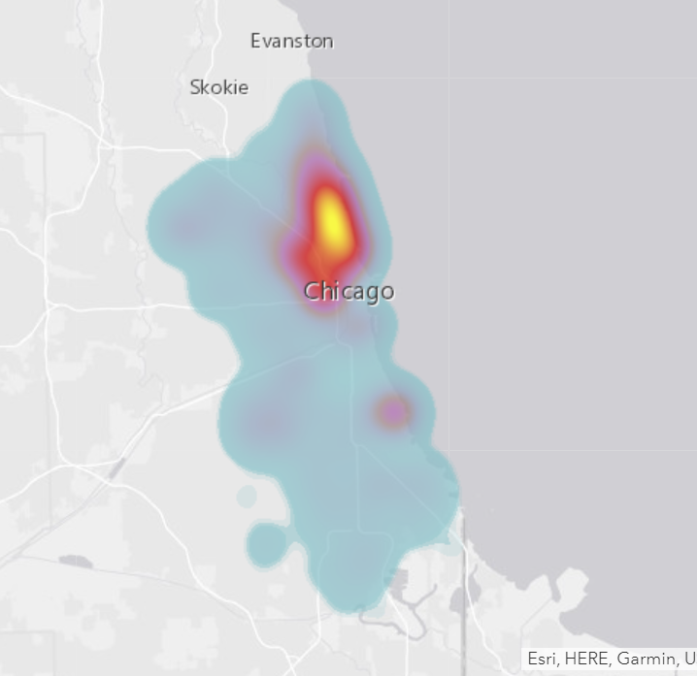
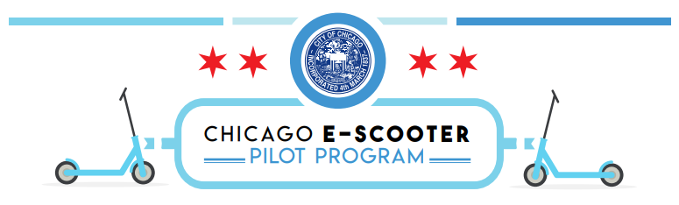
Questions: Who currently has access to scooters?
E-Scooter Trips 2020 (more than 630,000 trips)
Natural and Built Environment (Schools, Transit Stations, etc)
Chicago Demographic Data-- US Census
Notes:
Job one for expanding transportation choices is shoring up current transit system, and then helping the communities connect to transit stops. so we need to improve local, block-by-block transit access for folks who are most in need: the middle- and low-income resident who are less likely to live within walking distance of a convenient bus or train option. Every neighbor deserves the same access to our entire city — a neighborhood network. shared e-scooters and e-bikes can provide that missing link, giving people the means to access transit stops that were previously accessible only by a long walk or expensive car ride.
Whether there is an imbalance in demand for Scooter and whether it will give residents an unfair right to use the scooter will be determined by the following features. vehicle flow imbalance happens when riders take more vehicles from one place than other riders bring in. from map most trips take place in the North-East of the city. If suppliers do not rebalance aggressively, vehicles will be concentrated in a few regions and user in other region will not have scooter in time.
To solve this, we will build a model using these features, including the city's demographic characteristics, socioeconomic and natural & built environment characteristics, to make predictions.
Designed to help city officials have a better understanding of the current scooter accessibility and predict the geographic distribution of scooter riders in this year and understand its relationship to the social and economic geography of the city.

Slide 4
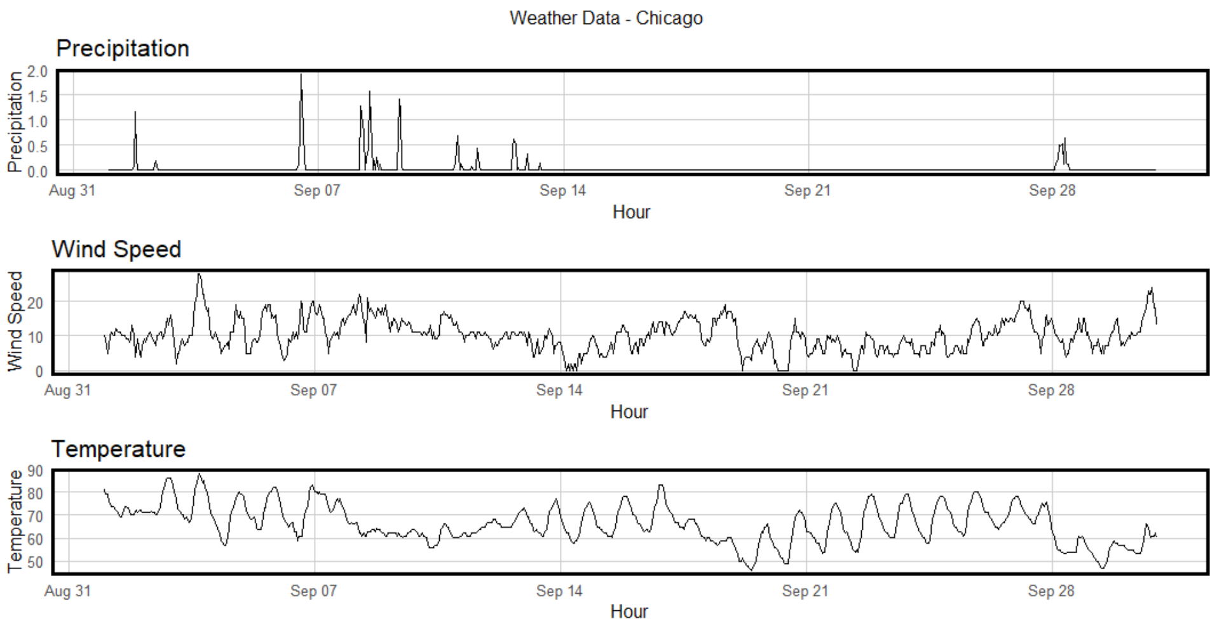
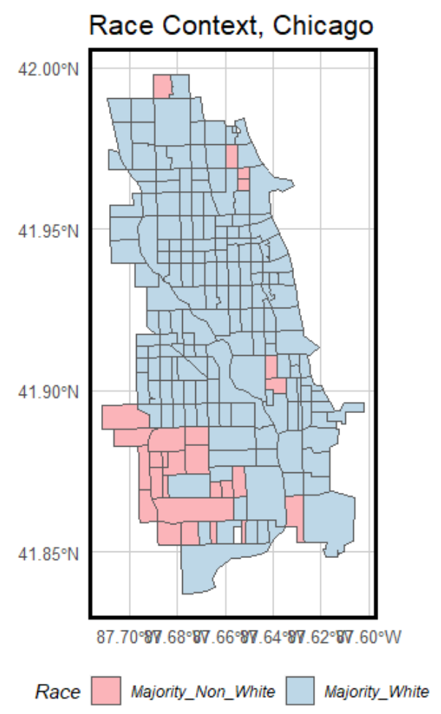
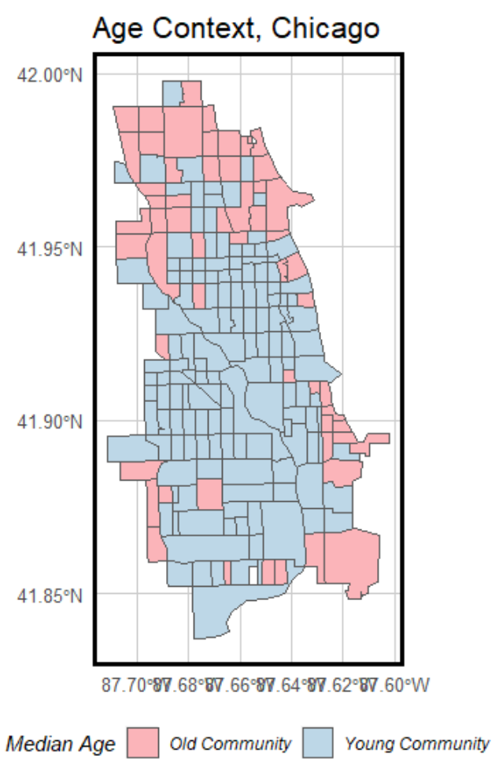
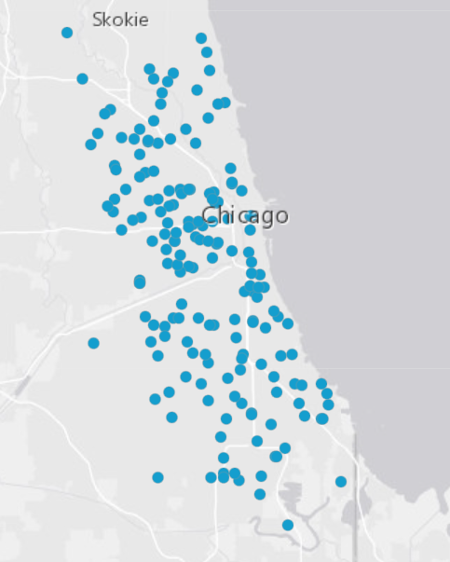
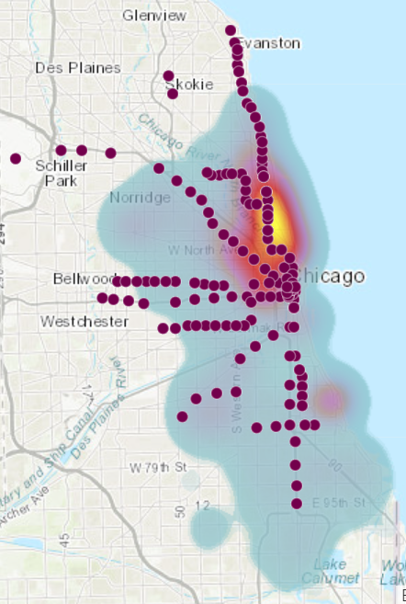
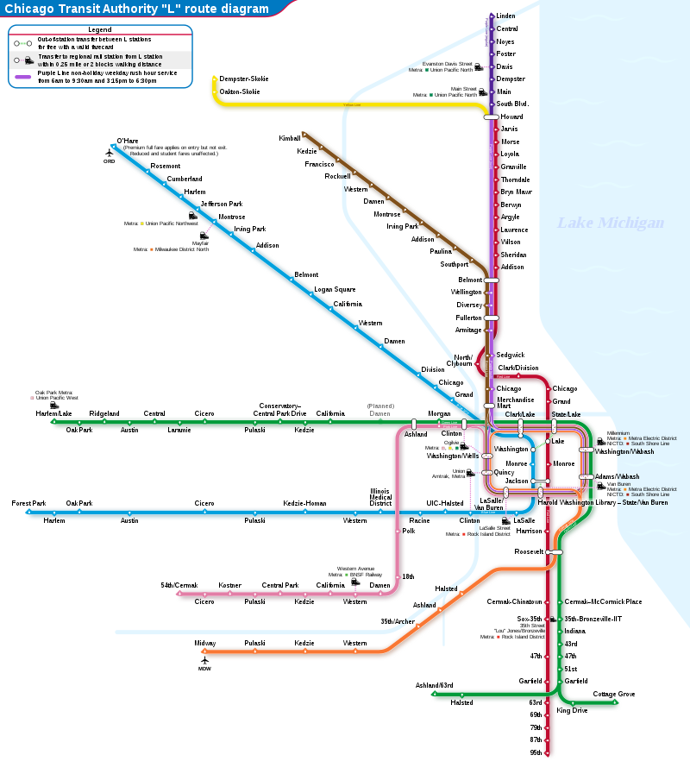
Factors affecting travel
- Natural (precipitation, temperature, wind)
- Built Environment (transit, shopping, restaurant, school)
- Socio-economic (house income, race, age)
High Schools
L Stations
Notes:
it is a four months program from summer to winter, we want to know whether natural factors affect people travel or not within a year, or a day, when is the scooter demand more
This is the weather condition in Chicago in September 2020, less precipitation, large temperature variation
These variables reflect both the potential demand for scooters in census areas and the likelihood that suppliers will provide more vehicles in an area.

Slide 5
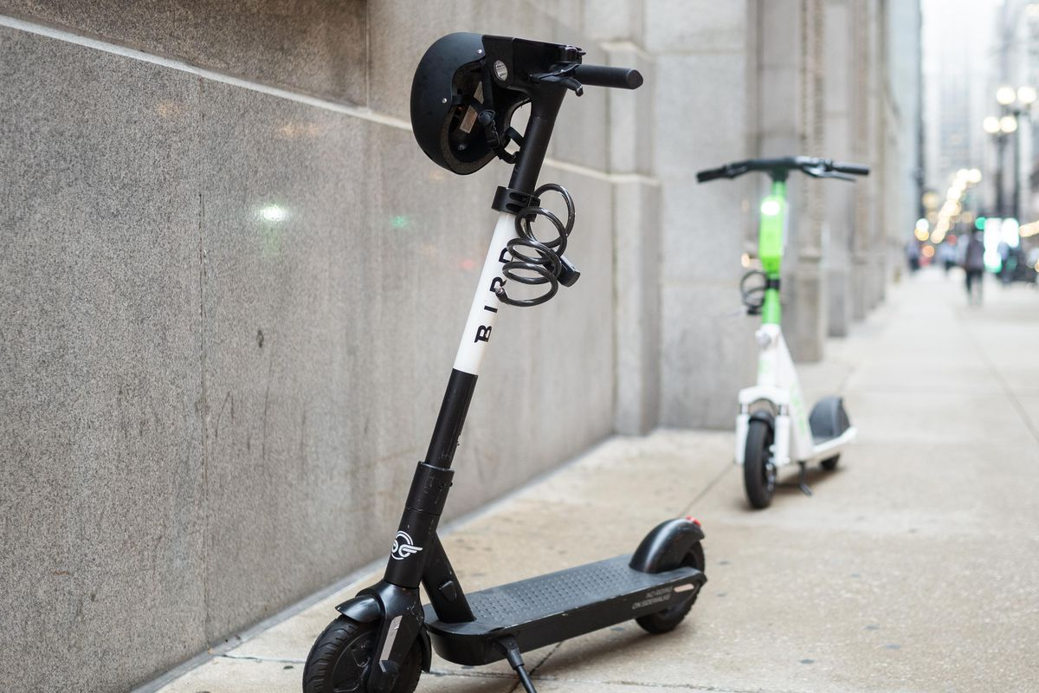
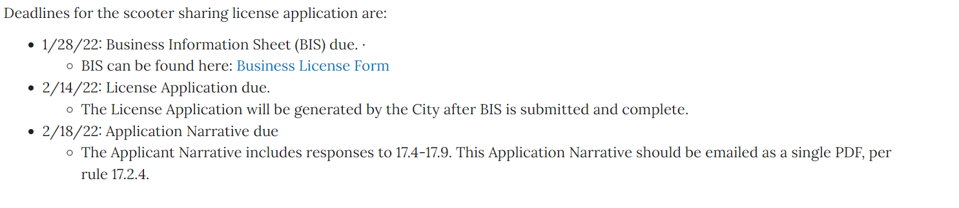
Future Works:
Built environment
Model & Prediction
Vendors--- Priority area?
Permanent Scooter Program from 2022 ?
https://www.chicago.gov/city/en/depts/cdot/supp_info/escooter-share-pilot-project.html
Notes:
Find the link between the Built Environment and Scooter Demand
Does no have a pilot program last year, but in October 2021, the City Council approved an ordinance creating a new 2-year scooter sharing business license. Want to have a permanent scooter program from 2022. lime more riders due to its lower price in priority area, combine with demographic and built environment features, it is the current priority area let more people have the access to scooter or need to improve.

